Slide 1

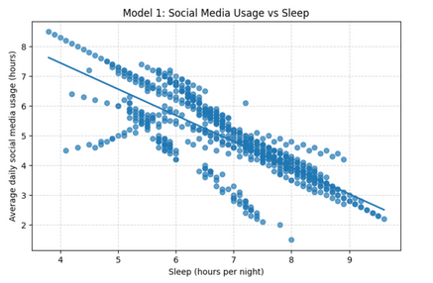
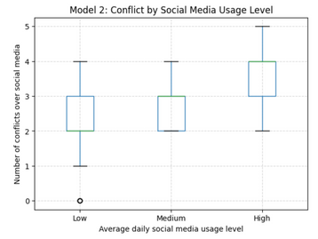
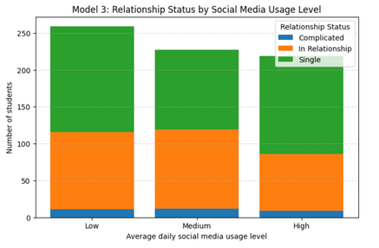
Social Media Usage and Student Well-Being: ​
Associations With Sleep, Conflict, and Relationship Status​
E
MORY
Rollins School of
Public Health
Amy Hunt & Victoria Ostebo
Emory University
Abstract/Intro/Motivation
Results
Conclusion/ Future Directions
Results
Research Question:
This study seeks to understand whether average daily social media usage (hours/day) is associated with sleep duration, interpersonal conflict, and relationship status in a student dataset spanning multiple countries.​
Background:
Social media usage is widely used by high schoolers, undergrad and graduate students and higher use has been linked to various health and lifestyle outcomes. Past research has indicated that electronic use, particularly before bedtime, can lead to worse sleep quality and conflicts within relationships (Clayton et al., 2013; Lemola et al., 2015; Scott et al., 2019).
We are interested in social media usage among students (16-25 years), using more recent data spanning various countries. This research could contribute to a growing body of literature examining the outcomes related to increased usage of social media within this population. Further research can build on this to assess and create appropriate health interventions that address the effects of social media amongst students.
MODEL 1: Social Media and Sleep
Conclusion
There is a negative association between hours of social media usage and hours of sleep per night (Model 1)
On average, higher social media usage was associated with lower hours of sleep of night
There is a positive association between hours of social media usage and number of social-media related conflicts (Model 2)
Students who spent more time on social media had more conflicts than those who did not
Model 1 assessed the association between average daily social media usage (hrs) and sleep per night. A negative linear relationship was observed according to the graph suggesting that higher social media usage is associated with fewer hours of sleep per night.
MODEL 2: Social Media and Conflicts
Future Directions
Model 2 assessed differences in number of conflicts by media usage level categorized as low, medium or high. The median number of conflicts progressively increase by from the low (2), to medium (3), to high level (4). This indicated that higher social media usage level is associated with increased interpersonal conflict.
Future research should attempt to collect longitudinal data following students over extended periods of time. This could assess whether social media usage can be a predictor of health outcomes rather than reflecting simple correlations. Additionally, since social media platforms vary in their offerings and how they are utilized future research could determine whether certain platforms are associated with particular health outcomes.
Methods
Dataset: Students’ Social Media Usage (Kaggle), ages ~16–25, students across multiple countries.
Independent Variable:
Avg_Daily_Usage_Hours
Dependent Variables:
Sleep_Hours_Per_Night
Conflicts_Over_Social_Media
Relationship_Status
Preliminary Analysis consisted of descriptive statistics and data cleaning.
This was followed by linear regression to evaluate model 1 and 2, and a multinomial logistic regression for model 3.
Limitations
Cross-sectional data
Self-reported measures
MODEL 3: Social Media and Relationship Status
Citations
Model 3 explored the distribution of relationship statues by social media usage. Students in the high usage level were more likely to report being single than the medium and low usage groups. The low usage group had the highest number of individuals that were in a relationship. This suggests that heavier social media usage could be associated with differences relationship status.
References
Lemola, S., Perkinson-Gloor, N., Brand, S., Dewald-Kaufmann, J. F., & Grob, A. (2015). Adolescents’ electronic media use at night, sleep disturbance, and depressive symptoms. Journal of Youth and Adolescence, 44(2), 405–418.
Scott, H., Biello, S. M., & Woods, H. C. (2019). Social media use and adolescent sleep patterns. BMC Public Health, 19, 1238.
Clayton, R. B., Nagurney, A., & Smith, J. R. (2013). Problematic social media use and romantic relationship outcomes. Computers in Human Behavior, 29, 1–10.
https://www.kaggle.com/datasets/adilshamim8/social-media-addiction-vs-relationships
Notes:
1

